Slide 1
Welcome to the December Q&A!
Trusts represented today include: North Bristol, Cambridge, Oxford, NNUH, Devon, Imperial, Salford, Brighton, Royal Free

Slide 2
Updates
Reminder to check your RPG membership is up to date
Large number of lapsed memberships, currently being checked against the Q&A whastapp group list
RPG conference 2024 11th/12th October - save the date!! ☺
Birmingham Arden Hotel
UK Kidney week 10-12th June 2024
Edinburgh Conference Centre
Liaise with Cathy Pogson to get involved (cathy.pogson@porthosp.nhs.uk)
Weekly teams chat for advanced/consultant portfolios
Email cathy.pogson@porthosp.nhs.uk if you would like to join

Slide 3
Updates
NICE TA: Empagliflozin - expected 20th December
CKD/DKD/Proteinuria
RPG have responded to confusion related emails
Plenty of CKD pathways
NICE TA: Budesonide (Nefocon) expected 20th December
IgA Nephropathy
Awaiting news re Blueteq approval required
UKKA Expressions of interest:
PD guidelines (closed)
BBV guidelines (due soon)
MPT Chair for patient education committee
MPT Chair for IPC

Slide 4
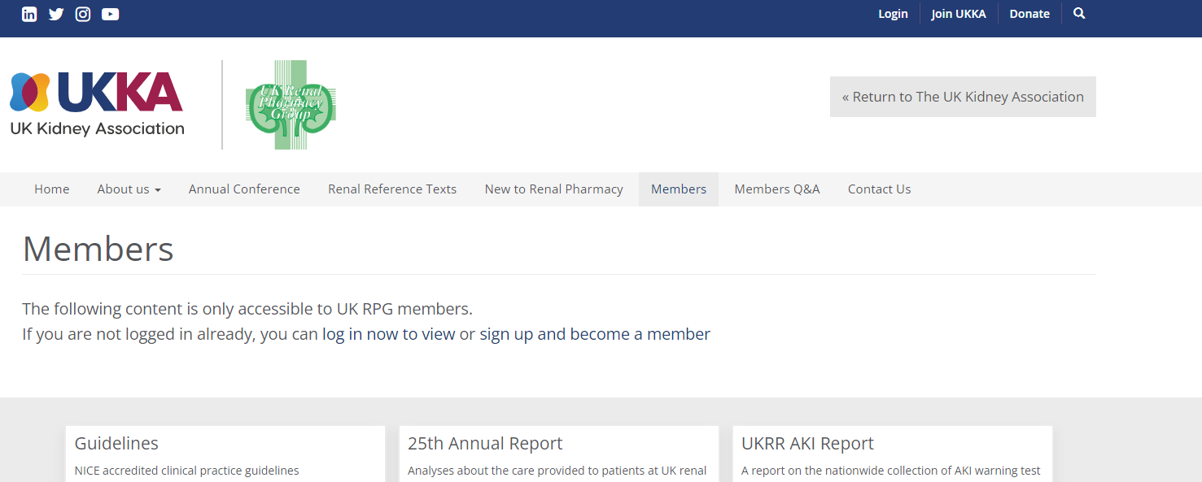
Updates
UKKA membership - Please can all members log into the website to check your renewal status
A number of Whatsapp members have lapsed membership and we are working to ensure all active Q&A members have a current membership
Check your contact emails +/- spam boxes as some of the renewals appear to be going there

Slide 5
Supply Problems
Alteplase OOS again
Bumetanide tablets OOS until January 2024
Ketovit – use Dalivet/Abidec drops
Vanquoral 25mg – resolved
Rixathon supply disruption - ? Resolved
10% Mannitol
Sometimes used at time of transplant, limited impact
Belzer MPS (perfusion fluid for machines)
resolved

Slide 6
Q&A Themes - Guidelines
Gentamicin in HD
Etelcalcetide in home HD
Pentosan guidelines
Guys able to send Oxford a protocol
Licensed option

Slide 7
Q&A Themes - Renal
Mg supps in Gitelmans
Info on mizoribine?
Sodium thiosulfate in low clearance pts
Treatment of anti GBM/double positivity?
Pre-emptive peri-operative lokelma?
Done for live donor pre-transplant for four days
Must ensure this does not become habit and other reasons for dialysis missed.
Audits for Lokelma indicating a lot of misuse
Patiromer cheaper option but less effective acutely
ATG + IVIG + PEX?
Voclosporin interaction with hydroxychloroquine
QT prolongation, ECG monitoring, stop hydroxychloroquine
Exercise induced itching in tolvaptan patients

Slide 8
Q&A Themes - Dialysis
Terlipressin on HD
Fosfomycin (po and iv) in HD
Etelcalcetide in home HD
Alteplase for tenckhoff’s
Bowel prep guidelines
Admin time for Ertapenem in HD (OPAT)

Slide 9
Q&A Themes - Transplant
Care with basiliximab expiry dates
Paxlovid & tac being used in Europe
Monitoring Mg in patients taking tac
Bristol only monitoring in low calcium
Oxford do not routinely monitor Mg – only if clinical need
RFH also no routine monitoring
Caution, particularly with PPIs

Slide 10
Q&A – New Qu
Salford – etelcalcetide, big drop in phosphate.
Not seen by other trusts, only profound drops in calcium

Slide 11
Q&A – New Qu
RFH – any experience in Filgotinib in dialysis?
Not seen by other units yet

Slide 12
Q&A – New Qu
NNUH – patient on phenytoin and itraconazole, relapsing, should you increase the steroid dose?
Don’t routinely change doses, change according to response

Slide 13
Q&A – New Qu
Guys – test doses for ATG
Always use test doses – not in SPC
First dose given more slowly at Bristol
Oxford – always used to give test dose but now so infrequent don’t tend to
RFH – give test dose
Manchester – no test dose but first dose over 12 hours
Brighton – no test doses, patients fine

Slide 14
Q&A – New Qu
Oxford – Inclisiran
Does it cause renal function to drop off? No signs of this for their patient
New drug for lowering cholesterol
No experiences yet

Slide 15
Q&A – New Qu
Derby – calculating renal function
When to calculate renal function, which calculation to use, how to teach junior pharmacists, when to reduce drug dosing
Old drugs have been validated against Cockroft and Gault, not a good measure of renal function
For toxic narrow TDM drug, use Cockroft and Gault
Must take extremes of body weight into account
Caution using eGFR in older patients

Slide 16
Q&A – New Qu
Steroid dosing post transplant kidney embolization?
?logic for indication
Not seen routinely elsewhere

Slide 17
December Q&A - Close
Thank you for attending!
Next Q&A: Tuesday 16th January
Keep in touch throughout the month on WhatsApp Q&A Group
>100 participants throughout UK and Ireland
Useful real time forum for clinical Q’s
Please consider joining!

