Slide 1
Welcome to the October Q&A!
Trusts represented today include: North Bristol, Cambridge, NNUH, Exeter, Northampton, Oxford, Cornwall, Ayrshire, Cork

Slide 2
Updates
Welcome to Olivia our new co-chair as Paul steps down from the clinical group to take up his chair elect post.
Congratulations and huge thanks to both Olivia and Paul
ERA membership available to all UKKA (RPG) members
Check your emails to provide consent
Reminder to check your RPG membership is up to date
Large number of lapsed memberships, currently being checked against the Q&A whastapp group list

Slide 3
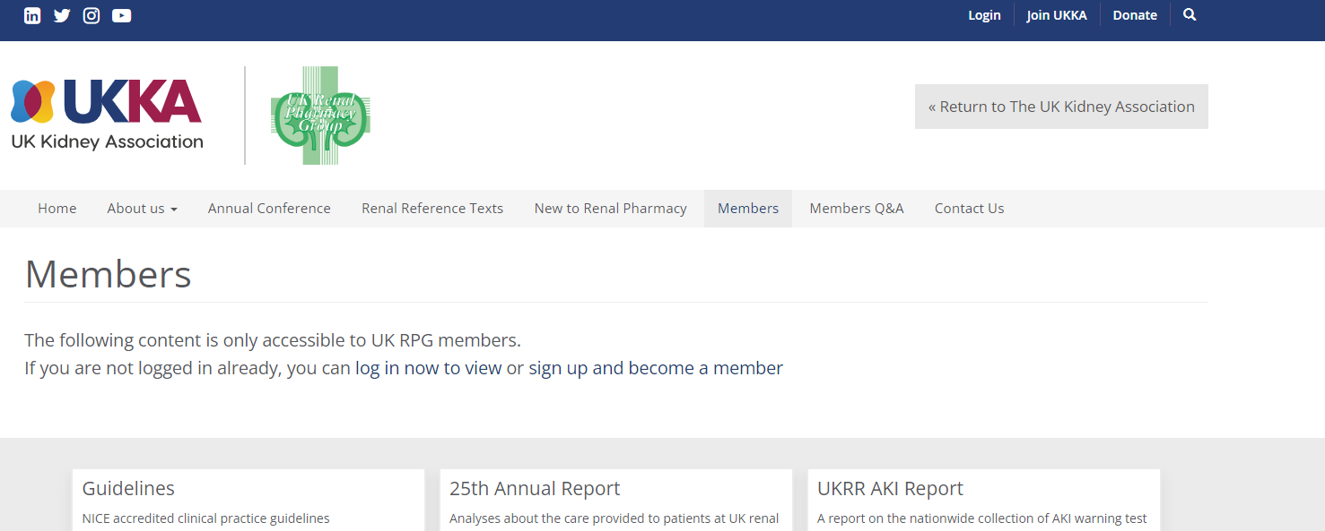
Updates
UKKA membership - Please can all members log into the website to check your renewal status
A number of Whatsapp members have lapsed membership and we are working to ensure all active Q&A members have a current membership
Check your contact emails +/- spam boxes as some of the renewals appear to be going there

Slide 4
Supply Problems
Alteplase OOS again
Addiphos being discontinued
Bumetanide tablets in Cambridgeshire – 1 mg tablets back in, 5 mg tablets not
Tiopronin – Ascot brand now available, Bristol able to get less expensive stock back in. 100 mg come out. Company to produce 250 mg early next year – more of a cost saving.

Slide 5
Q&A Themes - Guidelines
UKKA hyperkalaemia guideline for comments
Anaemia guideline
Steroid free transplantation guideline
Difelikefalin guideline
Webinar on 16th Nov @ 4pm
https://us06web.zoom.us/webinar/register/WN_WGu25cr3SHqyGZjmDrbenQ#/registration

Slide 6
Q&A Themes - Renal
Lokelma down enteral tubes
Alert cards for TIN
Tolvaptan counselling
Pyridoxine for primary hyperoxaluria
Drug removal during plasma exchange
Networking for research opportunities
Lumasiran funding
Gentamicin bladder washouts
LMWH in CKD4
Washout period for cinacalcet pre parathyroidectomy
Fungal prophylaxis with cyclophosphamide
Calculating GFR for DOACs
Fosfomycin prophylaxis
Avacopan supplies
Rituximab pre-meds

Slide 7
Q&A Themes - Renal
Forceval in renal impairment
Request for conference slides – investigating whether this is possible,
Statin dosing in CKD 4/5
Potassium binders as stock on units
Opioid substitution therapy in AKI
Hep B vaccine schedule
Empagliflozin license change – no NICE TA yet – expected 7th February 2024

Slide 8
Q&A Themes - Dialysis
Therapeutic LMWH in CKD5d – Renal Drug Database group working on anticoagulant monographs including practical clinical information.
Continuing Dapa in CKD5d
Vancomycin duration on HD
Fluconazole >800mg in CKD5d
Exit site preparations in chlorhexidine allergy
B3’s administering meds
Teicoplanin on HD
Triptans in CKD5d
IP vanc concentrations
Fondaparinux in CKD5d
Heparin flushes for new PD tubes
Liraglutide/Semaglutide for weight loss in CKD5d
Clarithromycin for exit site infection

Slide 9
Q&A Themes - Dialysis
Line locks in urokinase allergy
Apremilast in CKD5d
TPN on HD
Allergic reactions with Taurolock – Issue at Lister, but no issues elsewhere. Oxford – reaction to Citralock.

Slide 10
Q&A Themes - Transplant
Campath administration for transplantation – imlifidase patients will get it on day 4 on the ward.
Halving sirolimus

Slide 11
Q&A – New Qu
Alteplase to unblock PD catheter?
Cambridge had a protocol for using urokinase for this
Will ask on the whatsapp group if anybody has used alteplase

Slide 12
Q&A – New Qu
Line lock policy – trouble with difficult lines, using a lot of Alteplase. Citraflow, then use Taurolock U, using a lot of alteplase. Do other trusts use a different protocol in any way?
Bristol – use a range, some are locked with heparin
Cambridge – similar protocol to Exeter.
Aileen – similar protocol, also lock with heparin. Often not having dry weight appropriately assessed, running too dry therefore increased incidence of clots
Also consider dose of LMWH given into the circuit for patients with lines to prevent clots.

Slide 13
Q&A – New Qu
Vasculitis guideline – Exeter writing new guideline and wonder for these drugs but also in general which calculation for renal function is being used.
KDIGO – based on eGFR. Exeter use cockroft gault equation.
Been discussed before – not able to produce list, all use clinical judgement and a mixture of equations when calculating medication dosing.
Certain drugs need specific dosing but most drugs can use clinical judgement.
Ensure looking at trends not snapshot results.
RDD introduction will cover this.

Slide 14
Q&A – New Qu
Avacopan – second patient in Ireland. Blood tests and adverse effects to look out for.
Cambridge – high users of avacopan, advise monthly bloods tests (LFTs and FBC) followed by 3 monthly.
Data so far collected by Cambridge, Manchester and Lister suggests adverse effects are in line with that shown in the ADVOCATE trial.

Slide 15
Q&A – New Qu
Difelikefalin – finance issues at Oxford, pass through but trust on block contract so trust finance do not agree to pay, therefore unable to proceed in commencing patients.
Some discussion around protocol and when to start/stop patients
For the agenda each month for the Q+A while we get used to using the new medication.

Slide 16
Q&A – New Q
Avacopan – are we going to stop at 12 months?
Blueteq form does not specify.
Clinical trial – patients only took for 1 year.
Group unsure – Olivia to check with CM re CRG

Slide 17
October Q&A - Close
Thank you for attending!
Next Q&A: Tuesday 14th November
Keep in touch throughout the month on WhatsApp Q&A Group
>100 participants throughout UK and Ireland
Useful real time forum for clinical Q’s
Please consider joining!

